Slide 1
Vehicle count, speed and density estimation using ROI in YOLO
Prepared by: Saurav Barua

Slide 2
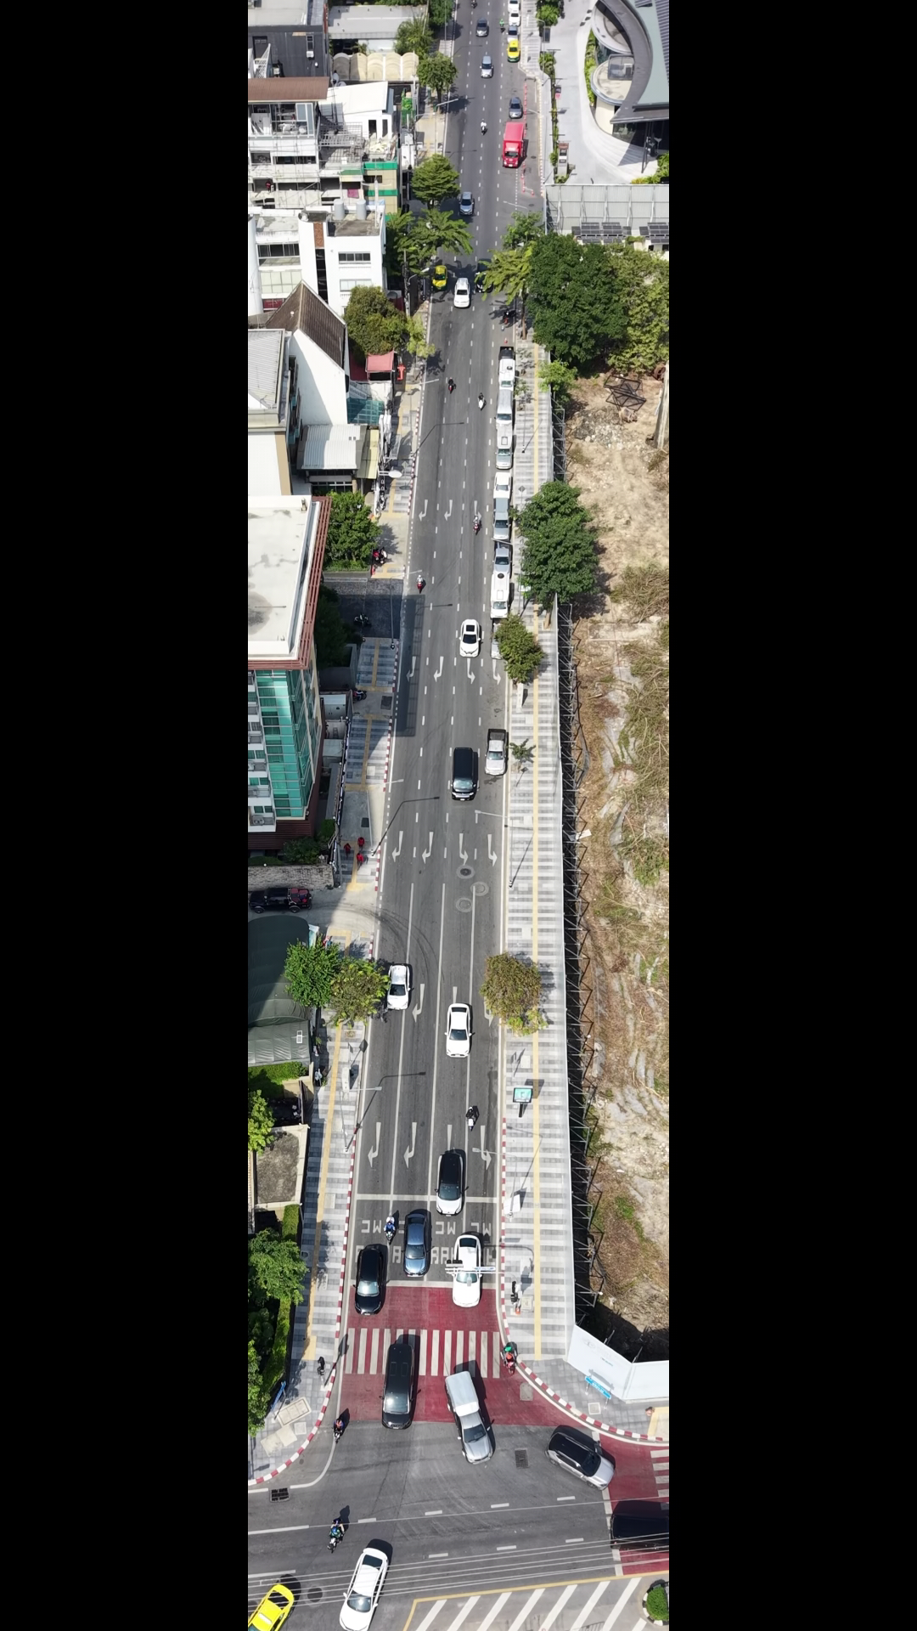
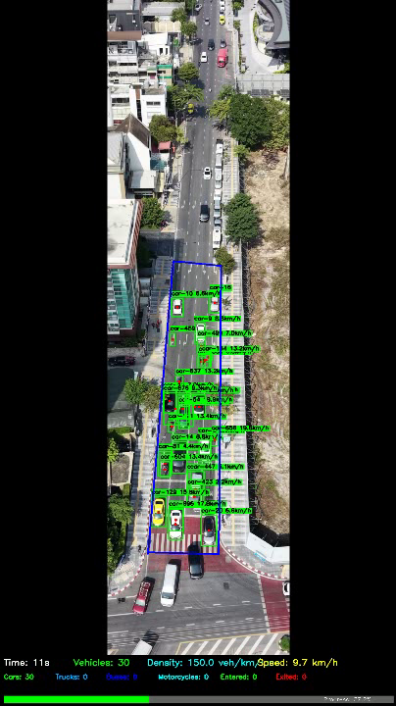
Traffic annotation
Video captured by Drone
Annotated Traffic Video

Slide 3
Work Steps
Annotate/label classified vehicle using RoboFlow box bounding and box prompting
Train data using python code in google colab
Prepare best.pt file
Python code in VScode to analysis traffic video using trained best.pt file
Create Region of interest (ROI) and calibrate distance with respect to pixel
Calculate traffic count in entry and exit of the ROI, average speed, average number of vehicle within ROI per second, average density
Plot vehicle count, traffic density and speed with respect to video run time.

Slide 4
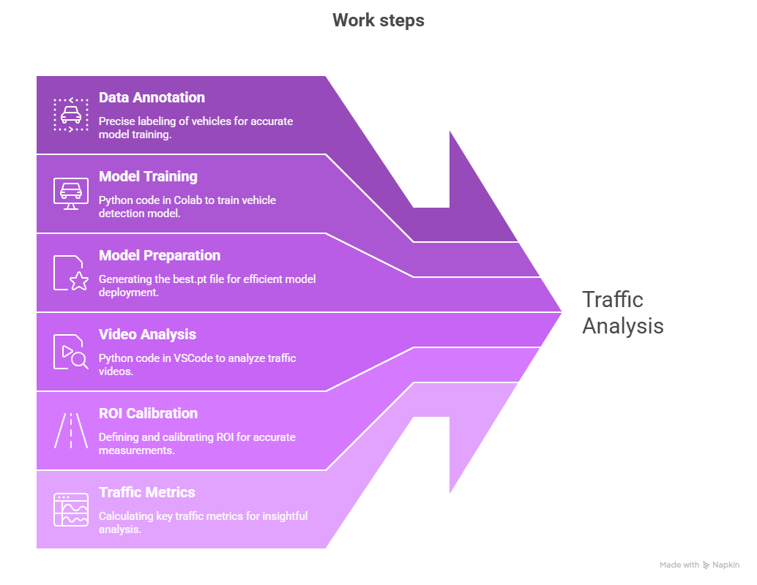
Flowchart of work steps

Slide 5
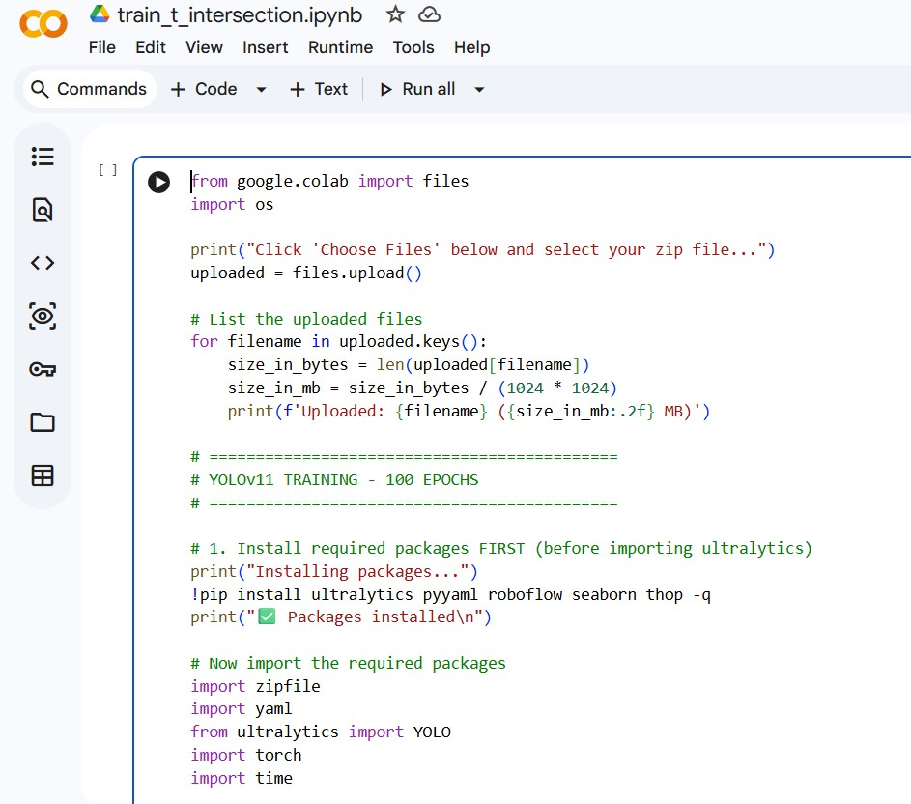
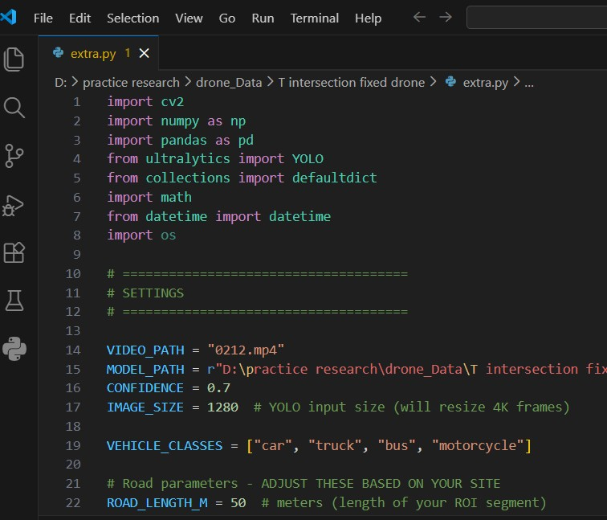
Google Colab and VS code
Screenshot of Python code in Google Colab
Screenshot of Python code in VS code

Slide 6
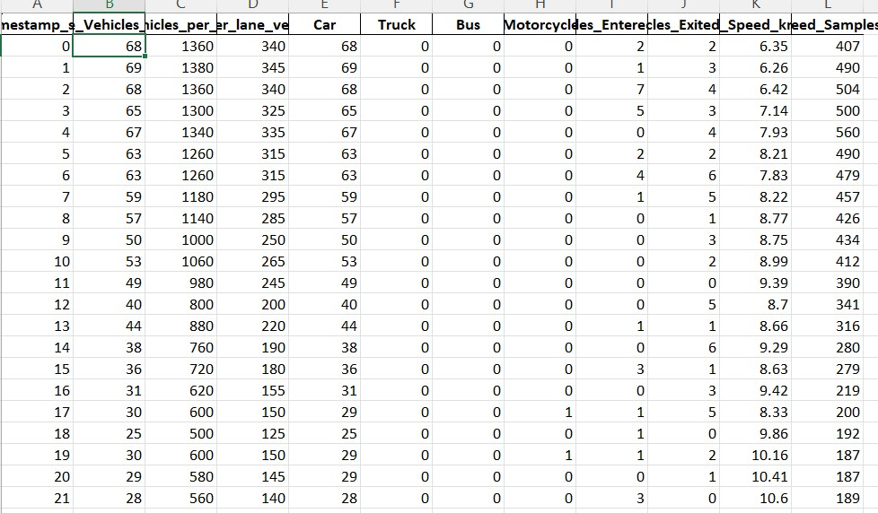
Excel output

Slide 7
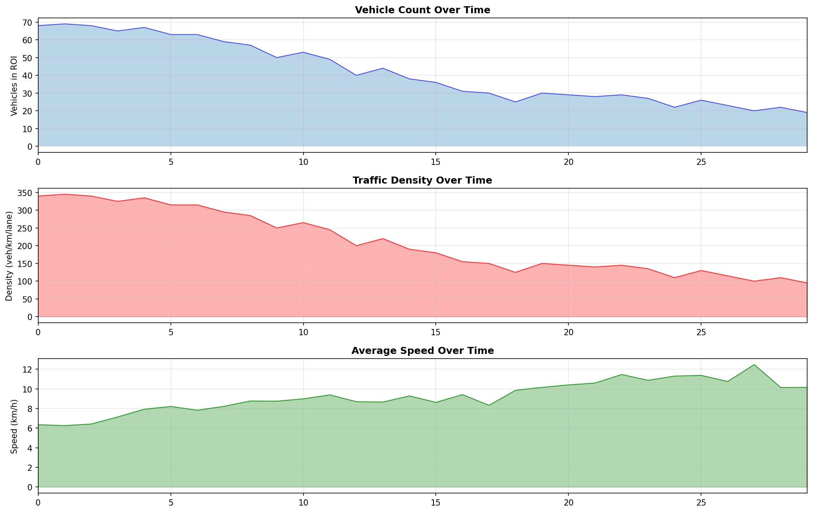
Graphical representation

